Slide 1
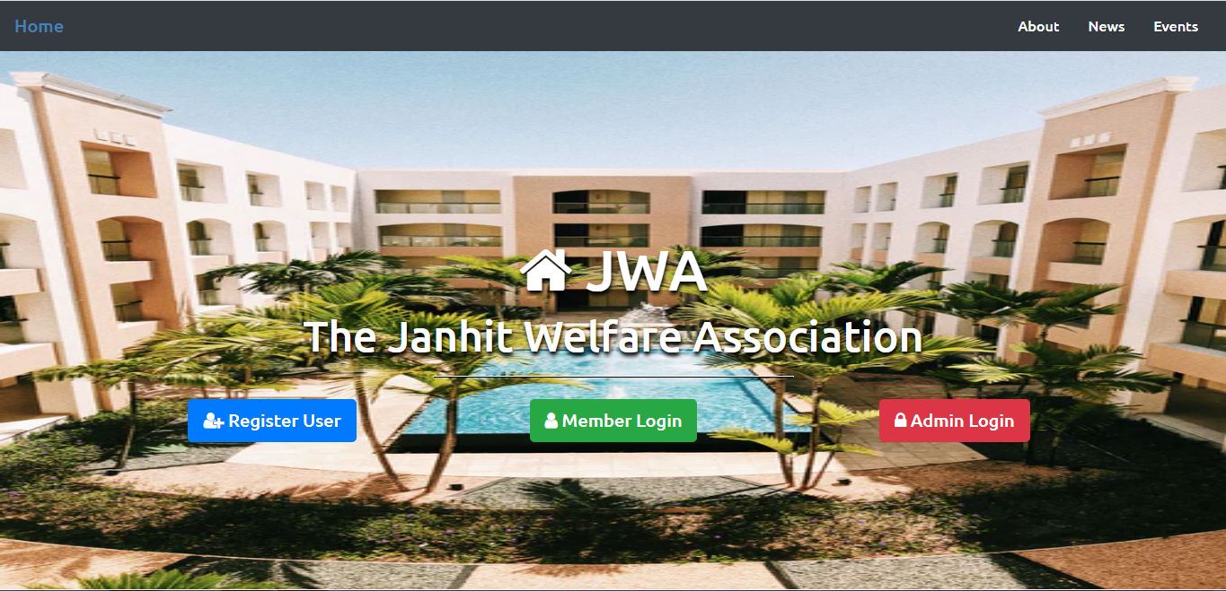
HOME PAGE

Slide 2
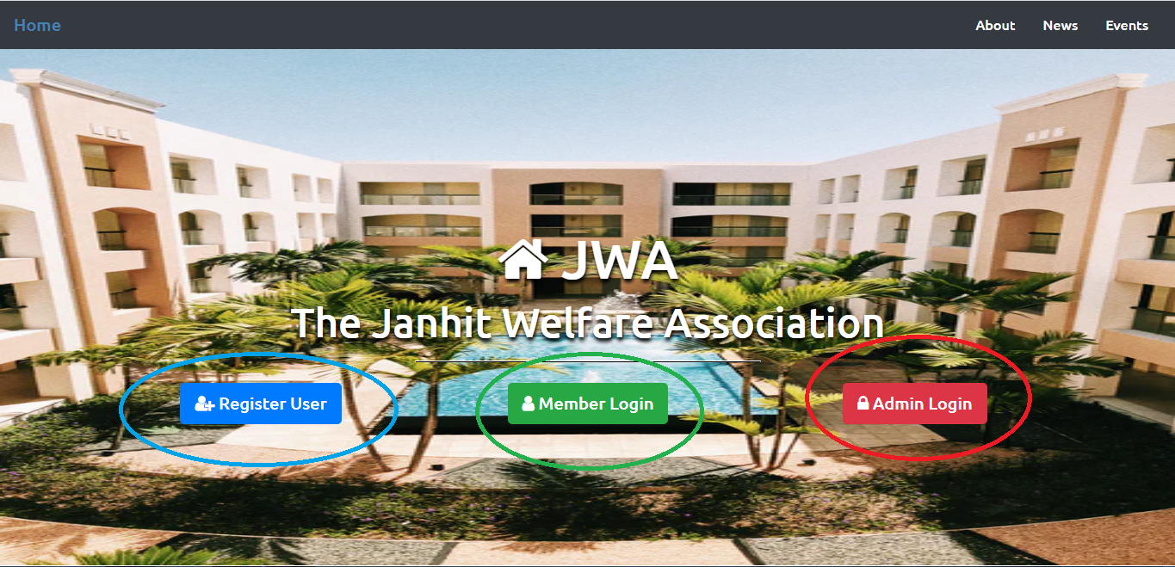
Home Page in which there is a navbar at the top of it and at the middle 3 buttons are there:
Register user: For registering for society.
User Login: Login for society members.
Admin Login: Login for admin/head of the society

Slide 3
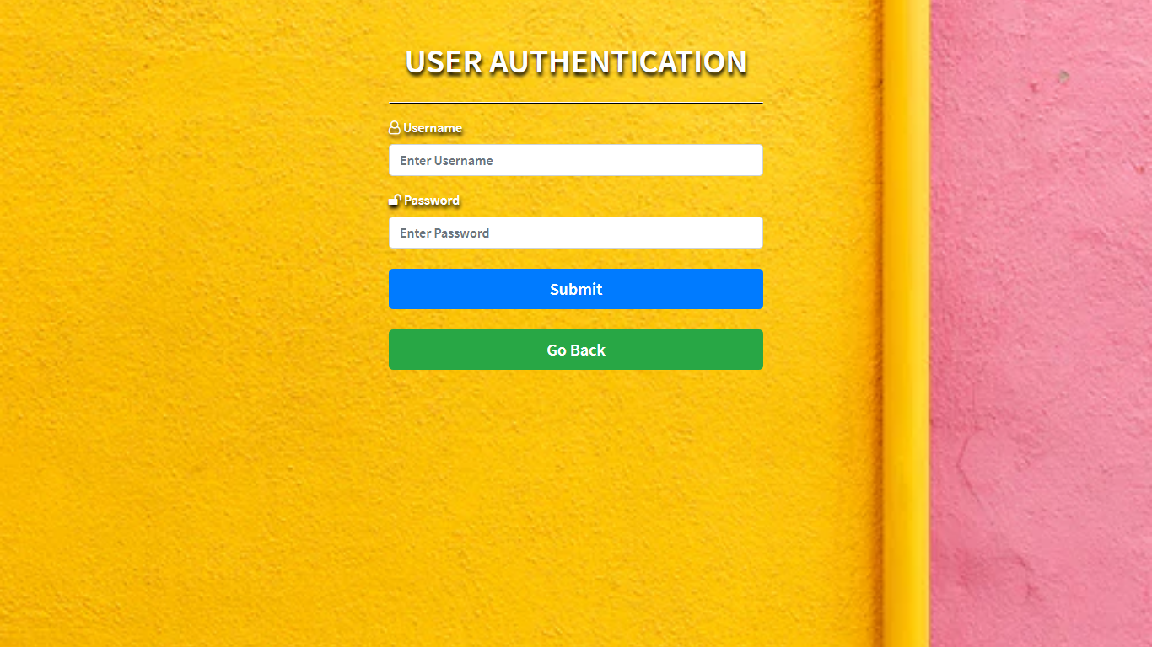
MEMBER LOGIN
Here member has to enter his/her username and password and then click submit(blue button) to open user’s dashboard.

Slide 4
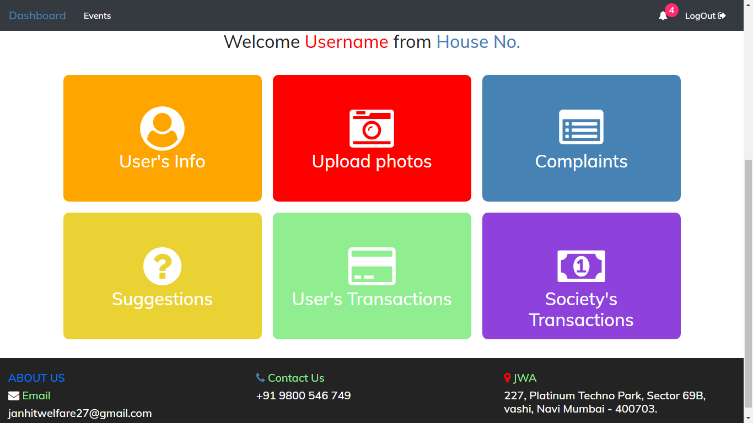
DASHBOARD of USER’S LOGIN

Slide 5
This is the navigation bar of user login page . It contains four options as follows:
Dashboard : List of various options like user info, transactions etc.
Events : Contains data of events held in society .
Notification bell : Redirects you to a page where you can see various notices.
Logout : Helps in logging out your page.

Slide 6
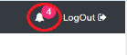
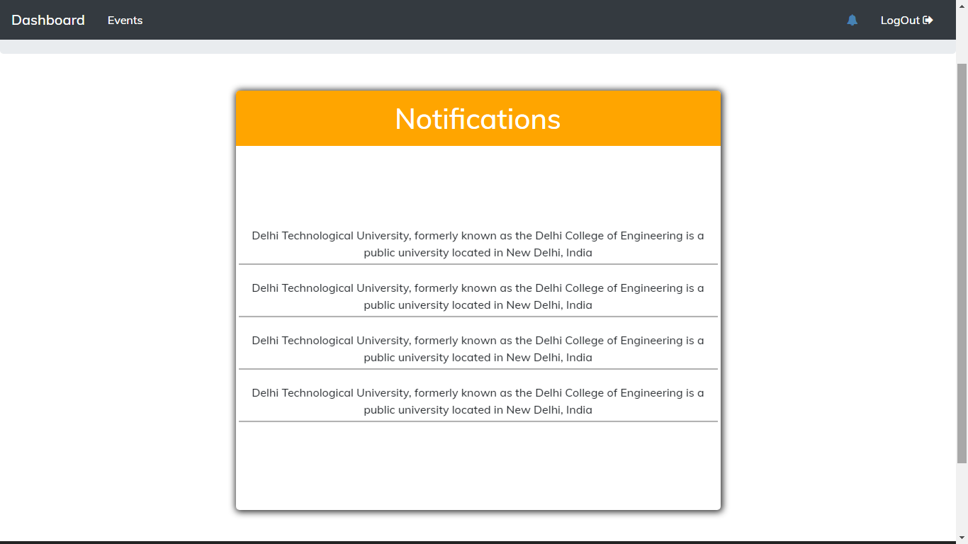
This is notification section in which user can see different notices regarding events ,changes ,payment dues etc.

Slide 7

USER’S INFO
Clicking on the red marked are redirects you to the following page.

Slide 8
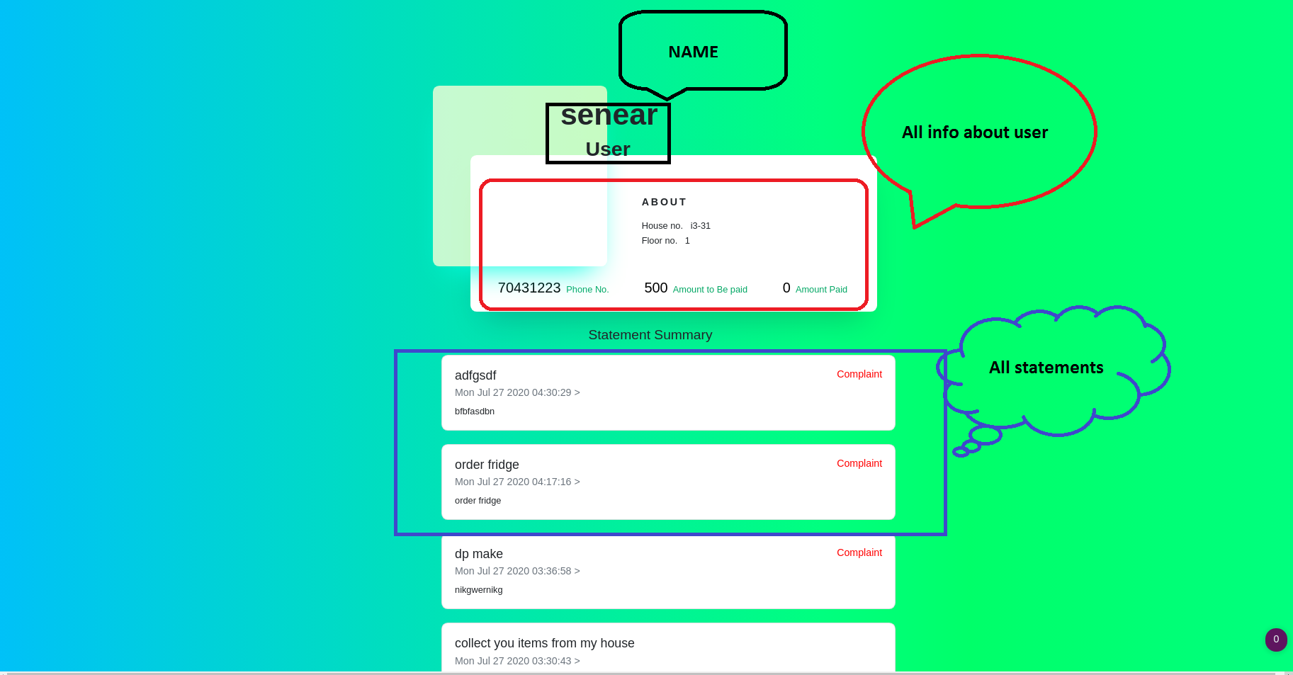
This is user’s info in which user details like name ,phone number,house number and statements can be seen.

Slide 9

COMPLAINTS
Clicking on the marked area opens the following page.

Slide 10
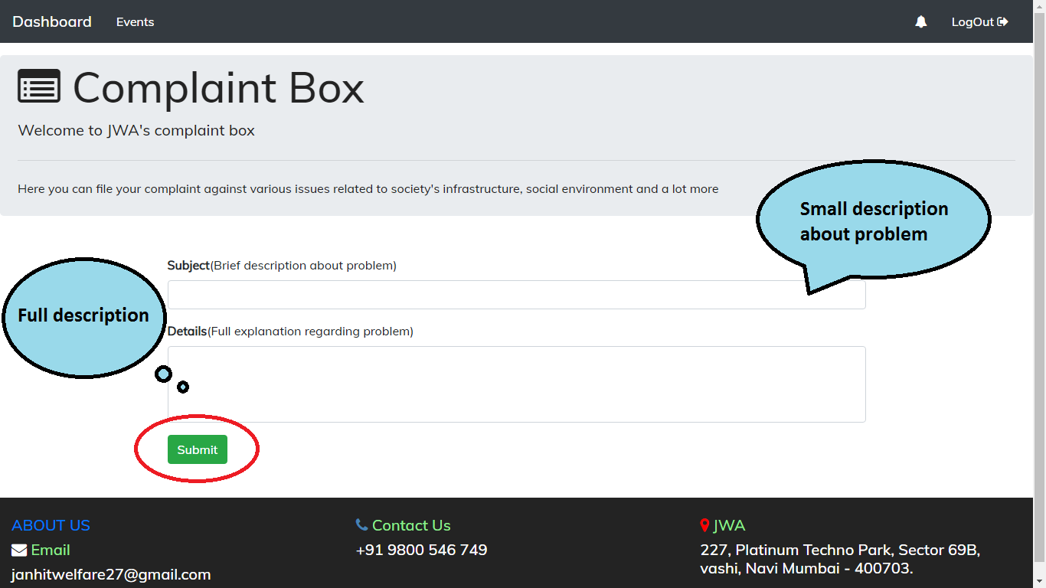
The image below shows complaint box in which one can write his /her complaints and then click on submit (red circled area) to file complaint.

Slide 11

USER’S TRANSACTIONS
Clicking on the red circled opens the following page.

